Slide 1
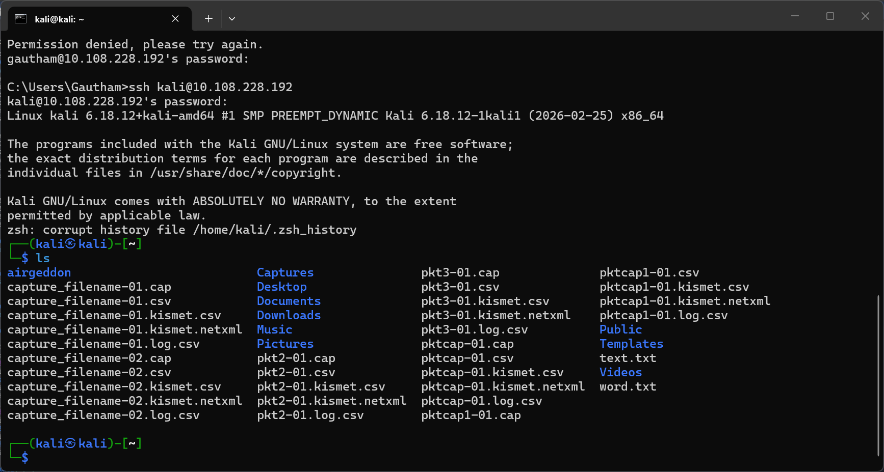
SSH

Slide 2
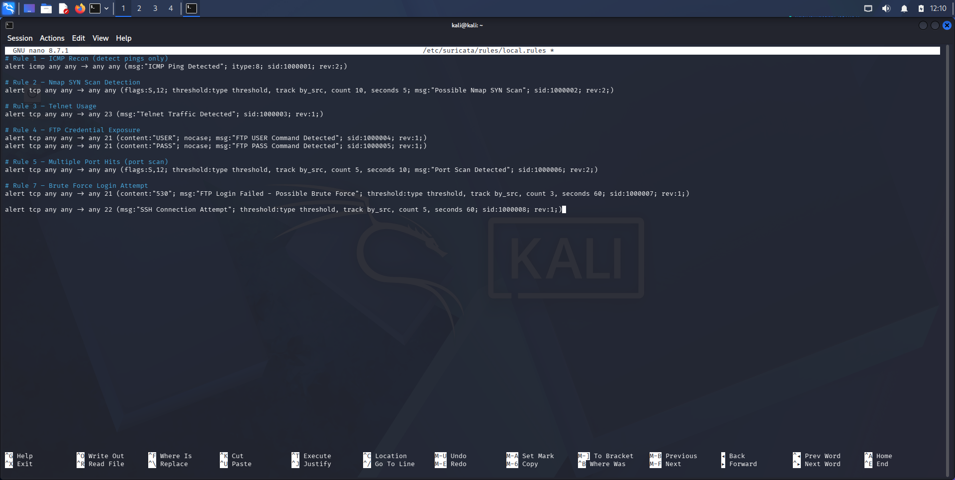
Adding rules for brute force for Suricata

Slide 3
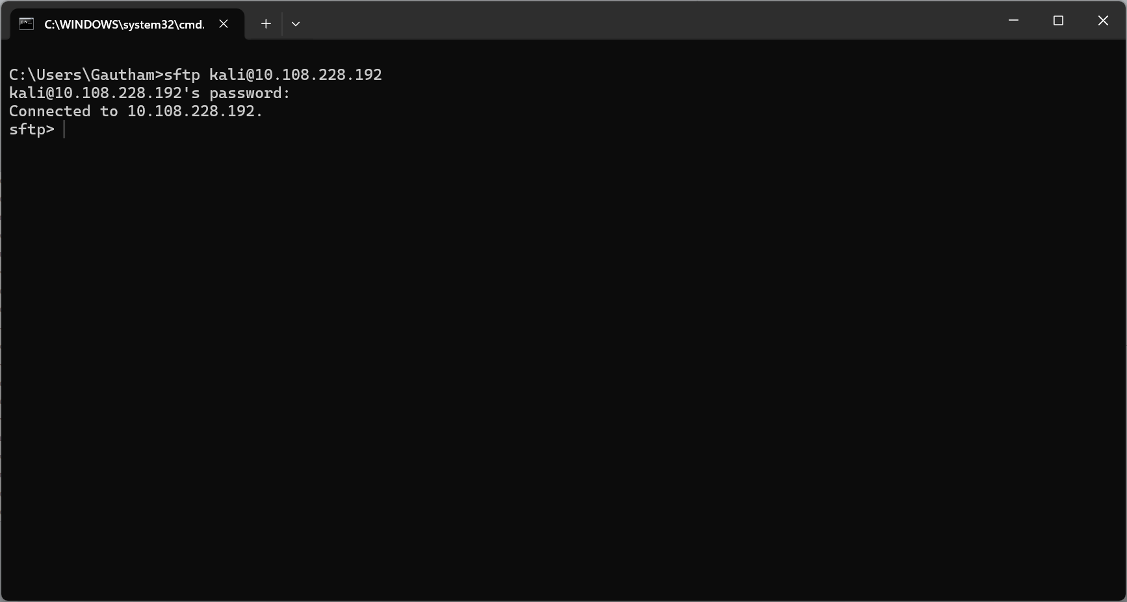
SFTP

Slide 4
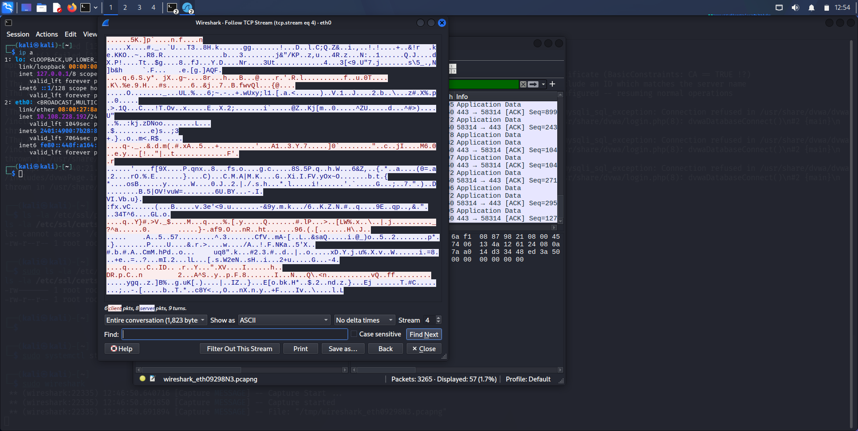
Encrypted TCP stream of dvwa

